Slide 1
INTEGRITY DRIVEN FACIAL RECOGNITION GUARDIAN USING DEEP LEARNING MODELS AND IDENTITY VERIFIER
MENTOR:
Aldo Stalin JL
​
TEAM MEMBERS:
Akshaya A
Indhra V
Priyaadharshini V S
Madhavan K S

Slide 2


Agenda
Abstract
Objective
Introduction
Existing System
Disadvantages of Existing System
Proposed System
Hardware and Software Requirements
Architecture
Module Split up
Reference
Conclusion
A

Slide 3
Abstract
Project Goal: Create a user-friendly website for students to lodge complaints.
Technology: Utilize facial recognition for secure access to the complaint system.
Focus: Emphasize simplicity in website design and complaint submission process.
Security: Ensure robust measures to safeguard student data and privacy.

Slide 4
Objective
This project aims to make it easy for students to complain using a website. We'll use facial recognition to make sure only students can complain.
We'll focus on making the website easy to use and keeping student information safe.
We'll also listen to feedback to improve the system.
Overall, our goal is to create a simple and secure way for students to raise concerns.

Slide 5
Introduction
Project Name: Integrity-Driven Facial Recognition Guardian
Purpose: Ensure secure and responsible use of facial recognition in educational settings.
Technology: Deep learning models for accurate facial identification.
Features:
Facial recognition from images/videos.
Mechanism for registering and addressing complaints.
Promotes accountability and ethical conduct.
Emphasis: Integrity, transparency, fairness, and privacy rights.
Objective: Create a comprehensive system for ethical facial recognition in education.

Slide 6
Existing System
Sno | Title | Description | Reference | Disadvantages
1 | Biometric Attendance Systems | Often use facial recognition technology for student and staff attendance | "A Review on Automated Attendance System Using Facial Recognition Technique," by Abhijeet Kumar et al. in 2019 International Conference on Intelligent Computing and Control Systems (ICICCS). | Accuracy Issues Bias and Fairness Concerns
2 | Access Control Systems | Employ facial recognition for secure access to buildings and restricted areas | "Facial Recognition Based Access Control System," by Syed Shabbir Ali et al. in 2018 International Conference on Computing, Power and Communication Technologies (GUCON) | Security Vulnerabilities Cost of implementation
3 | Smart Campus Solutions | Integrated systems for various campus activities, including attendance, security, and library access | "An Integrated Solution for Student Monitoring and Access Control System," by Syed Shabbir Ali et al. in 2019 IEEE International Students' Conference on Electrical, Electronics and Computer Science | Resource Intensiveness Legal and Regulatory Challenges

Slide 7
Proposed System
Integrity-Driven Facial Recognition boosts safety at schools by using smart technology to recognize faces and register complaints.
It doesn't just identify people.
It also lets students and staff report problems, making sure everyone acts responsibly and follows the rules.
It's not just about spotting faces – it also lets people report issues, making sure everyone behaves well and sticks to the rules.

Slide 8
Hardware and Software Requirements
Hardware Requirements |  |  | Software Requirements
Cameras | High-resolution IP cameras (720p (1280 x 720 pixels) | Capable of capturing clear facial images in various lighting conditions. | Facial Recognition Algorithm | Haar cascade algorithm and LBPH (Local Binary pattern histograms ) | Capable of accurately identifying individuals.
Processing Units | Powerful CPUs or GPUs | For fast image processing and facial recognition computations. | Identity Verifier Module | Local Binary Patterns(LBP) Operator module | For verifying the identity of individuals based on facial recognition data.
Storage | 120 megabytes for minimum number of students(60) | For storing image data and system logs. | Complaint Management System | Web-based or application-based system | For registering, tracking, and resolving complaints.
Networking Equipment | Reliable network switches and routers | For data transmission between cameras, processing units, and servers. | User Interface | Intuitive and user-friendly interface | For interacting with the system, including complaint submission and status tracking.
Server Infrastructure | Robust servers | To host the facial recognition algorithm, complaint management system, and other software components. | Security Protocols | Encryption protocols, access controls, and authentication mechanisms | To ensure the security and privacy of facial recognition data.

Slide 9
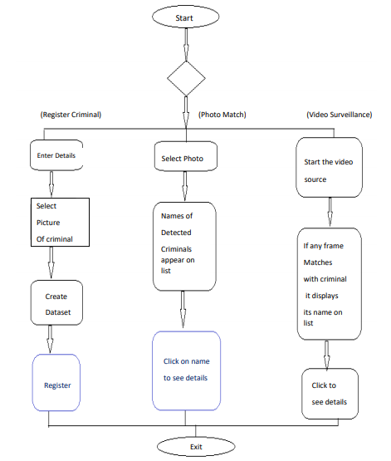
Architecture

Slide 10
Module Split Up
Module -1
Model Training Module:
Trains the facial recognition algorithm.
Module - 2
Complaint Management Module:
Manages complaint registration and resolution.
Module - 3
Facial Detection Module:
Locates human faces in images or videos.
Module - 4
Facial Recognition Module:
Matches detected faces with known identities.
Module - 5
Identity Verifier Module:
Verifies individuals' identities using facial features.

Slide 11
Module – 1 Model Training Module
This Trainer module code uses OpenCV to recognize faces in images.
It reads grayscale face images from a dataset folder from each and every input.
Each image is converted into a NumPy array and labeled with an ID for further use.
The face recognizer is trained with the labeled images and IDs, So that it can be easily accessed when required.
Finally, the trained model is saved for future use.

Slide 12
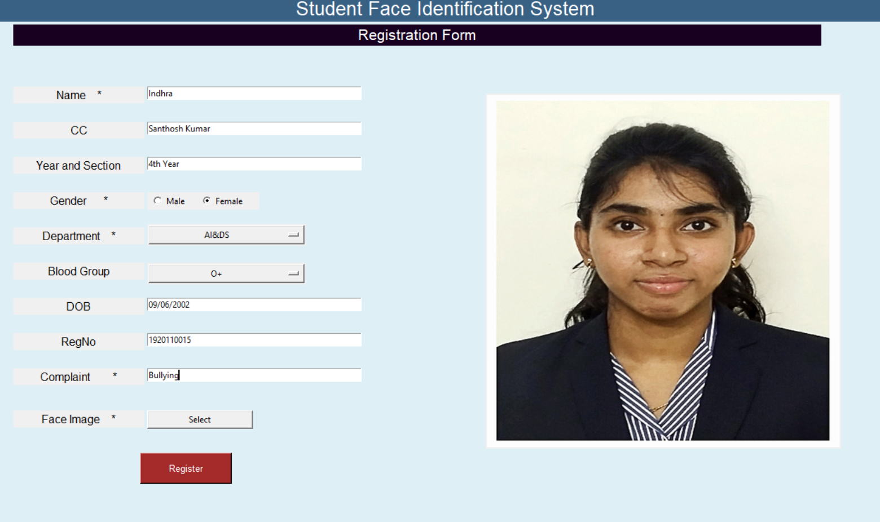
Module – 2 Complaint Management Module
Easy Complaint Submission: Users can easily tell us about their issues.
Keep Track of Progress: We'll let you know how we're doing with your complaint.
Getting Help to the Right People: We'll make sure your complaint goes to the right person to fix it fast.
Stay Updated: We'll keep you posted on what's happening with your complaint.
Learning and Improving: We'll use your feedback to make things better for everyone.

Slide 13
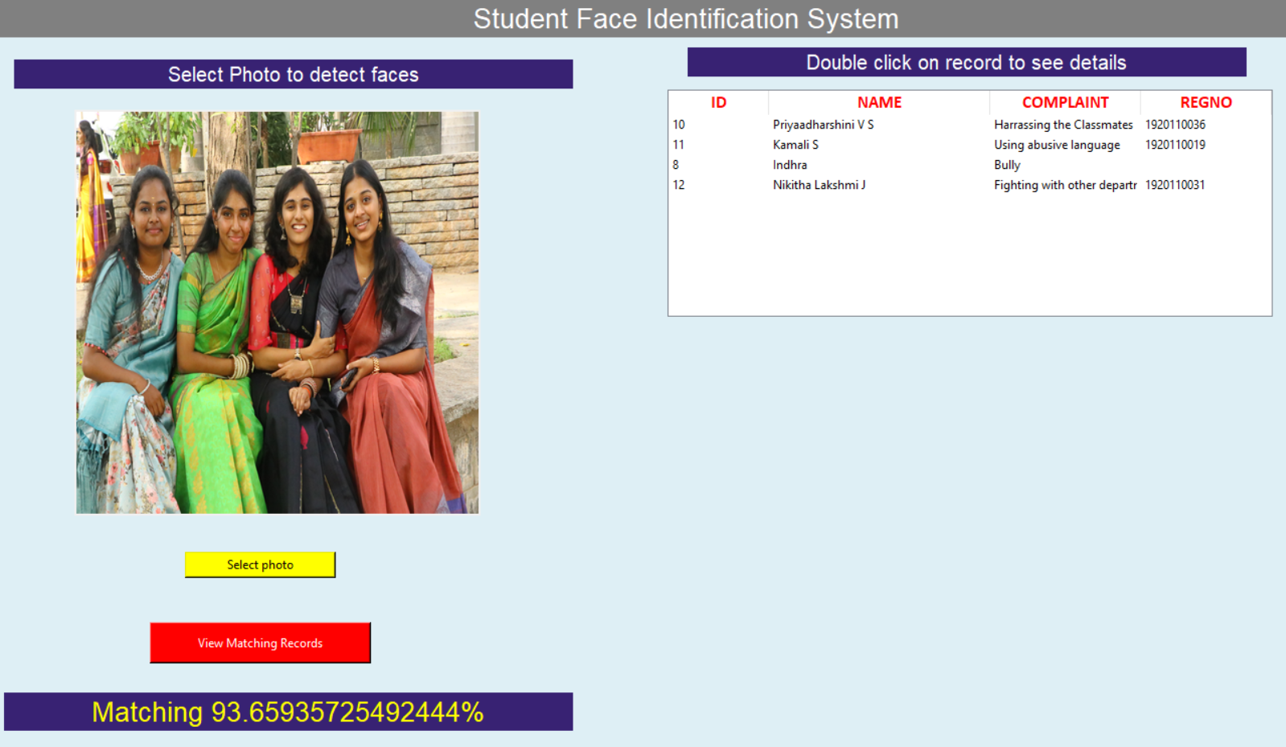
Module – 3 Facial Detection Module
Finding Faces: This module identifies where faces are in pictures or videos.
Image and Video Analysis: It looks at images or videos to spot human faces.
Recognition of Facial Features: It focuses on locating the key parts of a face, like eyes, nose, and mouth.
Works in Real-Time: It can do this quickly, even in live video streams.
Enables Face Tracking: Once it finds a face, it can keep track of it as it moves.

Slide 14
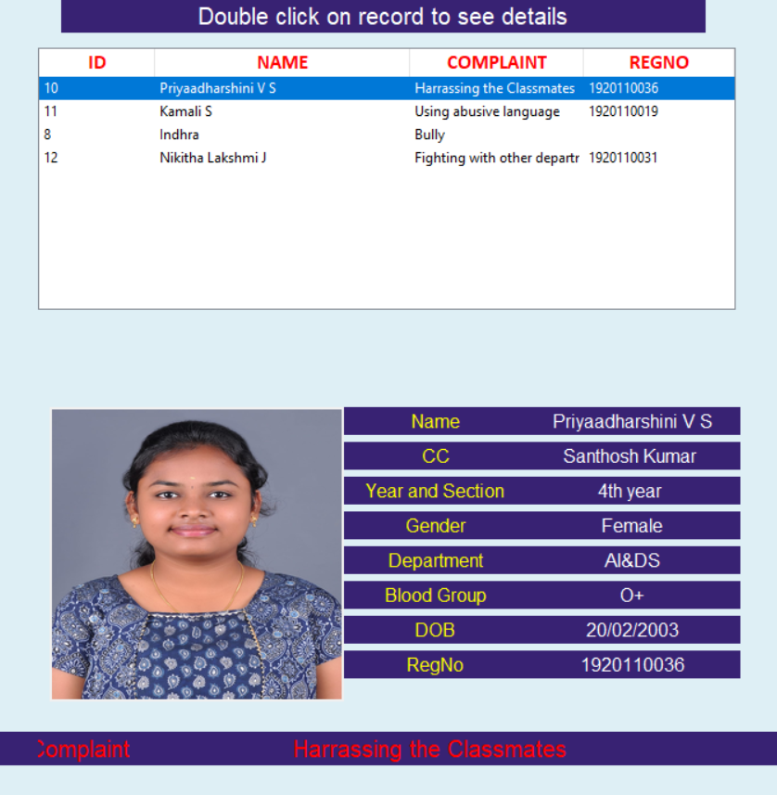
Module – 4 Facial Recognition Module
Matching Faces: This module compares detected faces with known ones to see if they match.
Identifying People: It helps figure out who is in a picture or video by comparing faces with a database of known identities.
Verification and Authentication: It confirms if a person's face matches their identity, like for unlocking devices or accessing secure areas.
Personalization and Customization: It can personalize experiences based on recognized faces, like showing tailored content or settings.

Slide 15
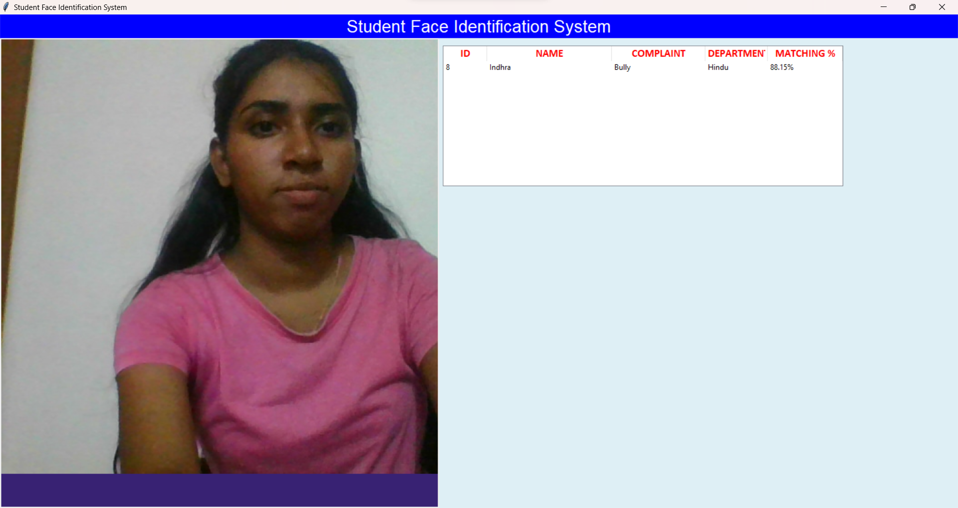
Module – 5 Identity Verifier Module
Confirming Identities: This module checks if someone is who they say they are by looking at their face.
Using Facial Features: It uses unique facial characteristics, like the shape of the eyes or the distance between features, to verify identity.
Authentication Process: It's like confirming a password, but instead of typing it, you show your face.
Security Measures: It helps ensure only authorized individuals access sensitive information or restricted areas.
Convenient and Efficient: It offers a quick and hassle-free way to verify identity, especially in situations where traditional methods may be impractical or inconvenient.

Slide 16
Conclusion
Better Security: Using fancy technology to make schools safer.
Making People Responsible: Making sure everyone behaves well because they know they're being watched.
Being Open: Making sure everyone knows what's going on and can see who's coming in and out.
Keeping Secrets: Making sure nobody’s personal stuff gets out there for everyone to see.
Fixing Everything: Making a plan and sticking to it to make sure everything works the way it should.
Doing the Right Thing: Making sure everyone is treated fairly and that we use technology in a good way.

Slide 17
Future Works
Light normalization can boost the threshold value, potentially enhancing face recognition accuracy across different lighting scenarios.
Future research could prioritize refining face recognition algorithms by incorporating specific facial features, like the distance between the eyes.
Analyzing facial structures in three dimensions using multiple camera angles represents a promising avenue for improving accuracy.
By leveraging these advancements, the likelihood of errors in face recognition systems is anticipated to decrease, leading to more reliable performance overall

Slide 18
Reference Papers
1. "Deep Learning Face Representation from Predicting 10,000 Classes" by Y. Taigman, M. Yang, M. Ranzato, and L. Wolf. Published in IEEE Computer Society Conference on Computer Vision and Pattern Recognition (CVPR), 2014.
2. "Complaint Management System: A Review" by P. Jha, P. Kulkarni, and K. Joshi. Published in 2016 International Conference on Computer Communication and Informatics (ICCCI), 2016.
3. "Joint Face Detection and Alignment Using Multitask Cascaded Convolutional Networks" by K. Zhang, Z. Zhang, Z. Li, and Y. Qiao. Published in IEEE Signal Processing Letters, 2016.
4. "FaceNet: A Unified Embedding for Face Recognition and Clustering" by F. Schroff, D. Kalenichenko, and J. Philbin. Published in IEEE Conference on Computer Vision and Pattern Recognition (CVPR), 2015.
5. "Identity Verification Using Facial Recognition" by N. Kumar, P. Belhumeur, and S. Nayar. Published in IEEE Transactions on Pattern Analysis and Machine Intelligence, 2012.

Slide 19
Thank you

